Slide 1
Functional Connectivity

Slide 2
Datasets:
1. 12 Active and 5 Sham MDD group EEG data of 32 channels (150 secs – resting state)
2. 26 Control group EEG data of 32 channels (TODO: secs – resting state)
Preprocess MDD with :
Setting custom montage (10-20 spacing) in Neurostim-32
Bandpass filtering (0.01-45)
Rereferencing (average)
Epoching 4 sec with 2 sec overlapping window
Preprocess Control with:
TODO:

Slide 3
Comparisons of functional connectivity between groups:
Group A: PRE Intervention vs Control
Group B: PRE Intervention vs POST Intervention for active stimulus
Sub Group C: PRE Intervention vs POST intervention for sham stimulus
Individual 1: PRE Intervention vs POST Intervention for active stimulus
Individual 2: PRE Intervention vs POST Intervention for Sham stimulus

Slide 4
Pipeline for all comparisons:
1. Iterate on each corresponding data of (pre-active/post-active/pre-sham/post-sham/pre-all/control).
2. Preprocess each individual data (montage/bandpass/rereferencing/epoching).
3. Find functional connectivity matrices of each data using PLI, also find PSD of each data.
4. Find average of all functional connectivity matrices in 2 GROUPS and also average of all PLIs in 2 GROUPS to compare both groups.
5.
8.
11. Binarized that matrix using threshold (Includes SWI group 1, SWI group 2, ratio of both groups,
optimal threshold)
12. Find asymmetry in each band
13. Plot difference matrix as group with more connections – group with less connections and observe dense connections regions
14. Measure the difference statistically which might be the results

Slide 5
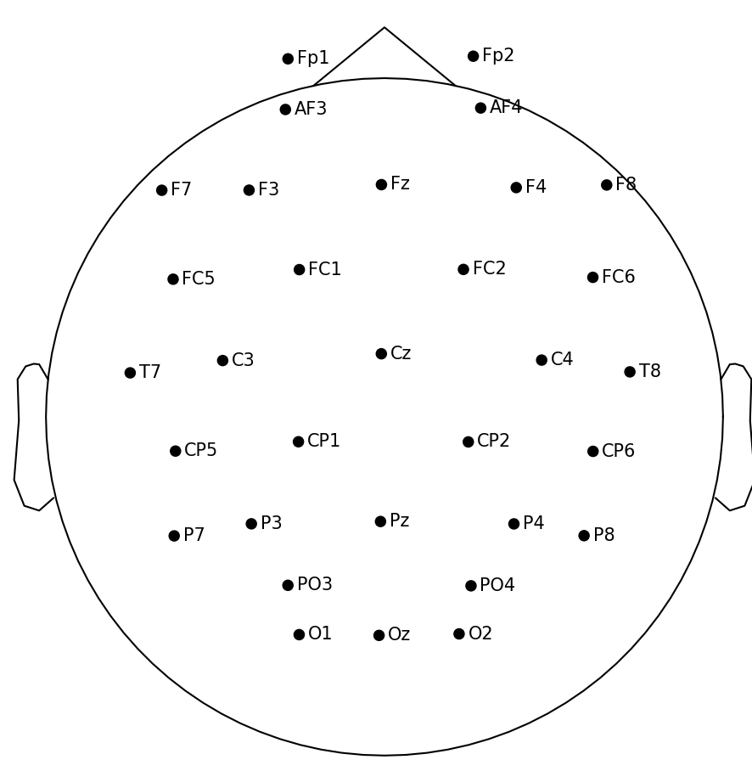


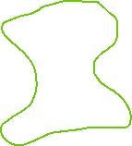

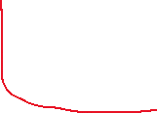


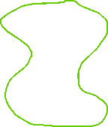
Left central 'LC': ['C3', 'CP1', 'CP5','FC1', 'FC5']
Left frontal 'LF': ['FP1', 'AF3', 'F3', 'F7’]
Left temporal 'LT': [ 'T7']
Left parietal-occipital 'LPO': ['PO3', 'P3', 'P7', 'O1']
Right central 'RC': ['CP6', 'FC6', 'C4', 'FC2', 'CP2',]
Right frontal 'RF': ['F8', 'F4', 'AF4', 'FP2']
Right temporal 'RT': ['T8']
Right parietal-occipital 'RPO': ['P8', 'P4', 'PO4', 'O2']
Current parcellation:
Division of channels into 8 brain regions

Slide 6
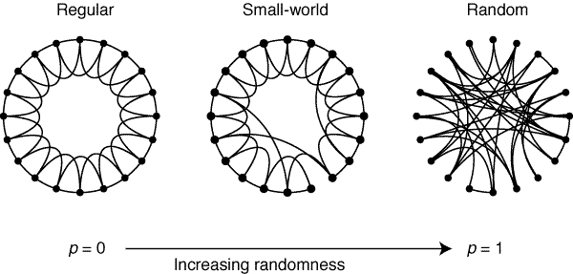
Watts Strogatz model – Small world network
Low Lavg
Low clustering
Low Lavg
High clustering
High Lavg
High clustering

Slide 7
GROUP B: PRE-ACTIVE vs POST-ACTIVE – To find effectiveness of intervention

Slide 8
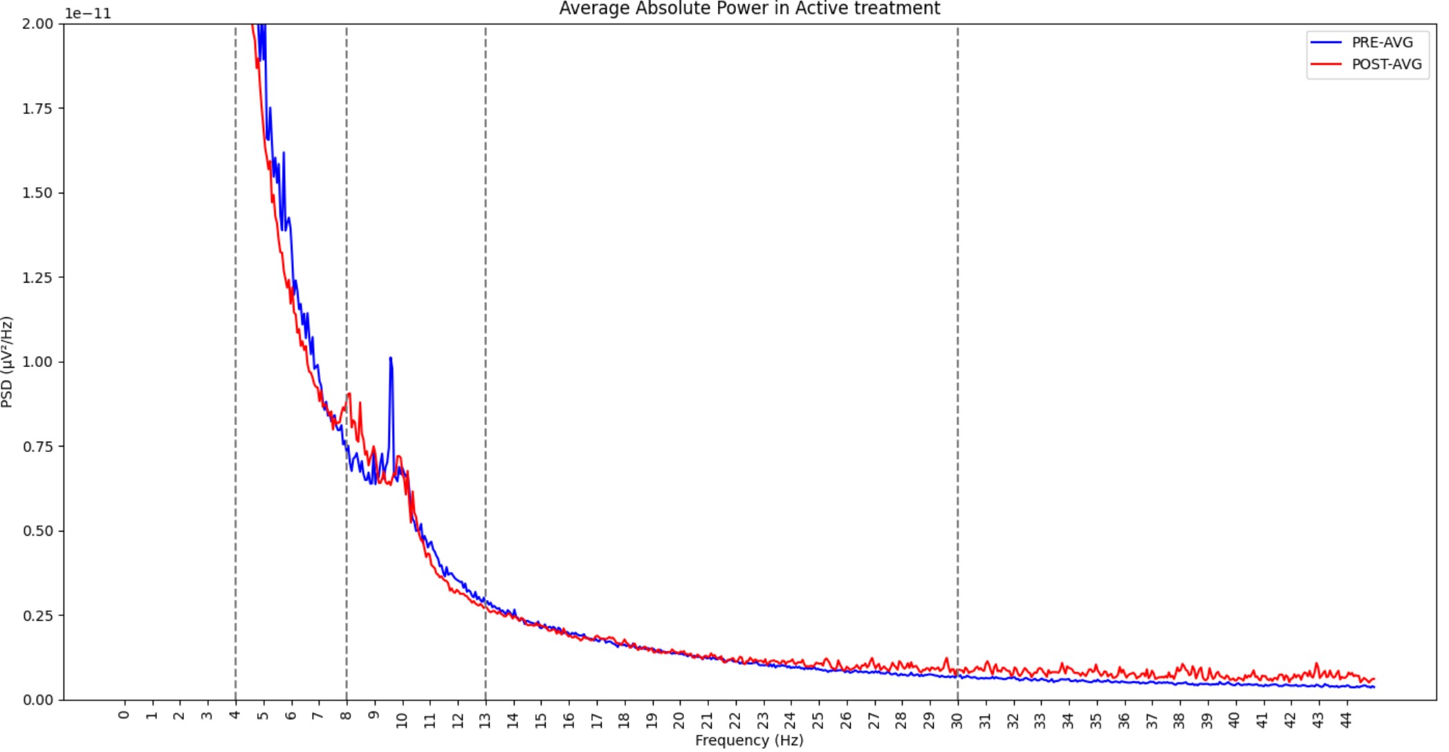

Slide 9
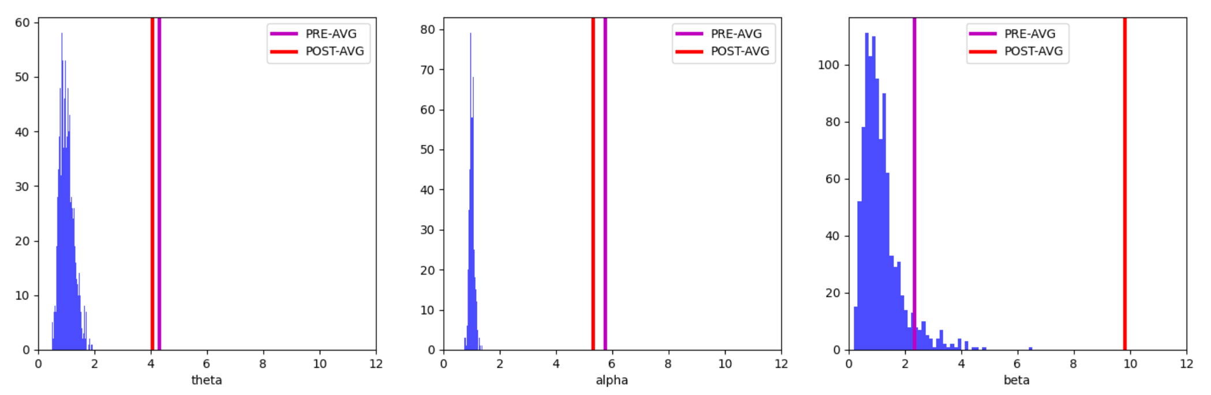
beta p-value:
Pre: 0.063
Post: 0.001

Slide 10
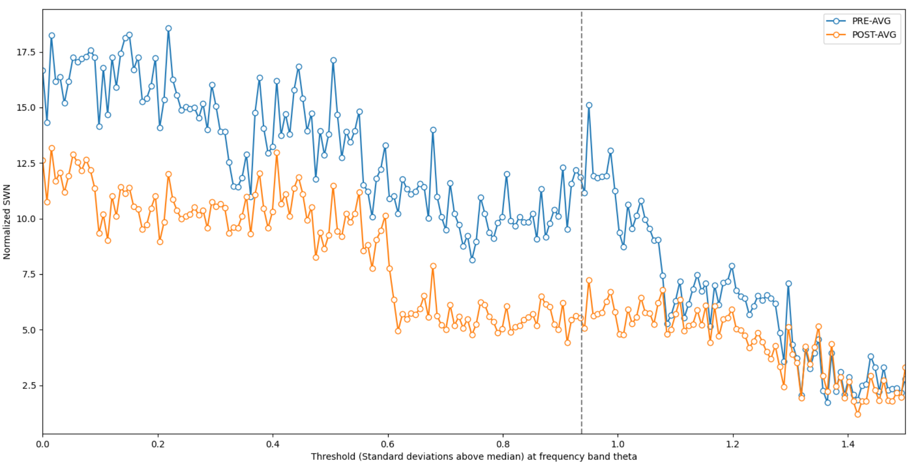

Slide 11
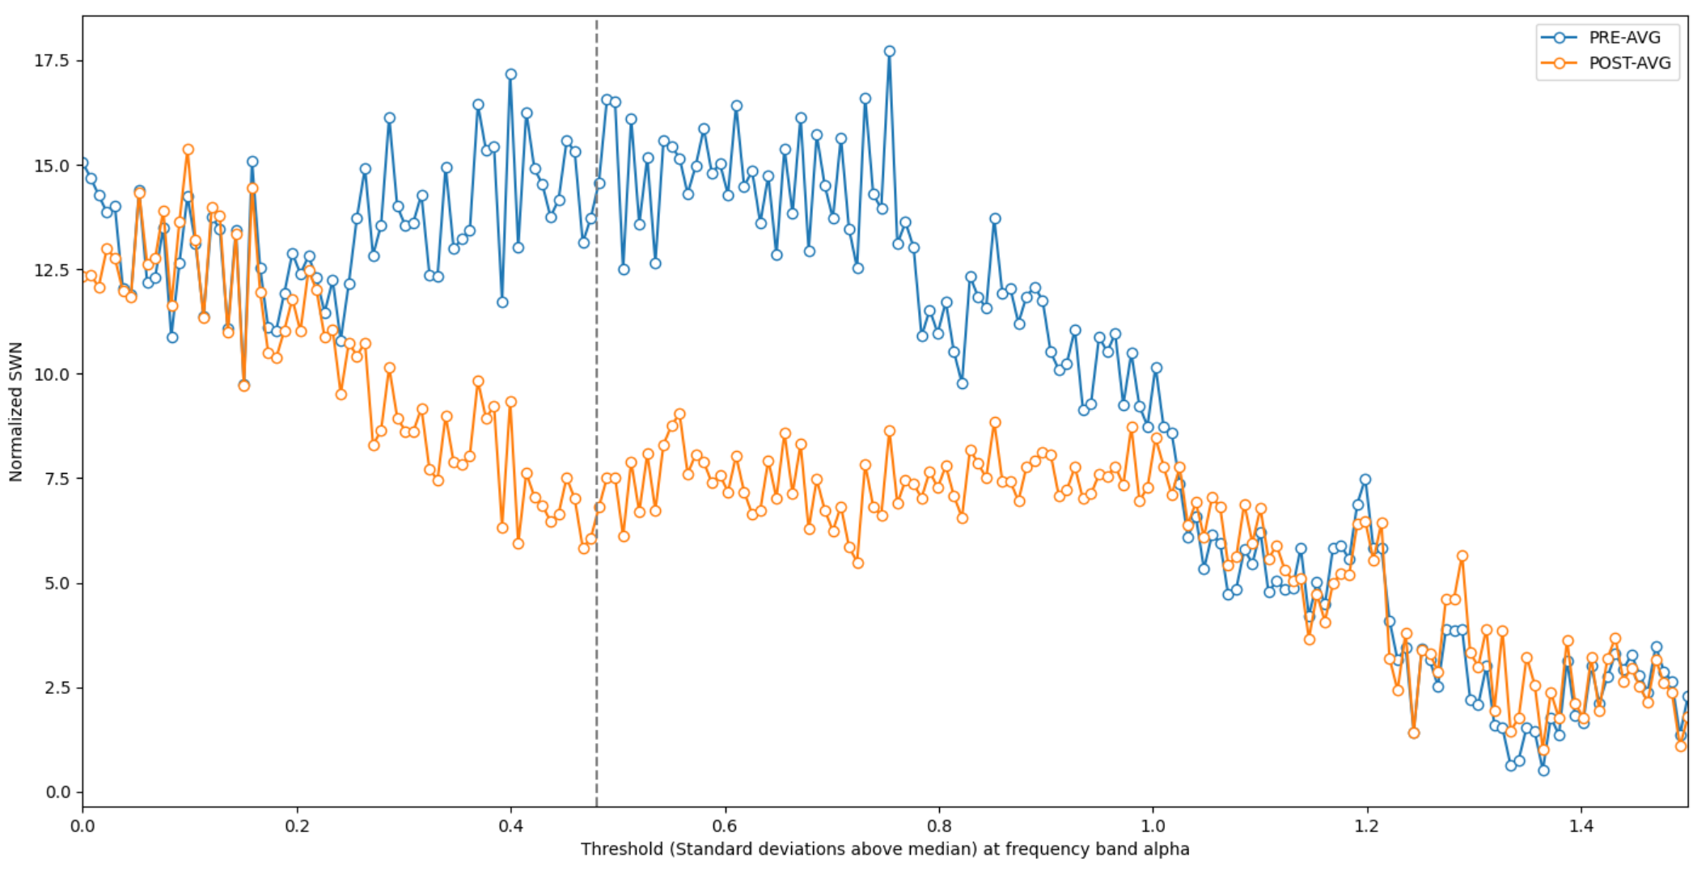

Slide 12
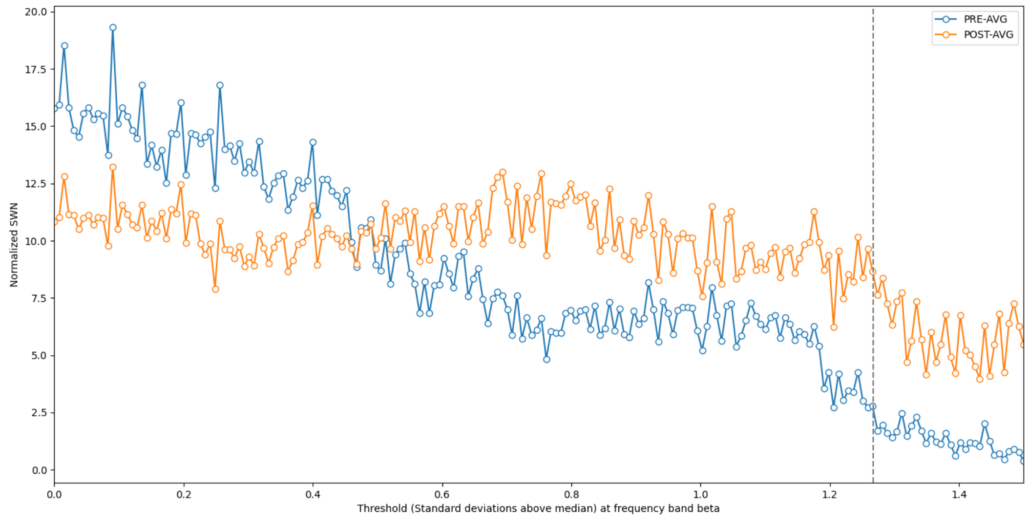

Slide 13
Common threshold: {'theta': 0.9422110552763826, 'alpha': 0.4824120603015075, 'beta': 1.2738693467336675}
Threshold for theta - Pre: 0.3962194915820743 Post: 0.4504460280832946
Threshold for alpha - Pre: 0.4340006222068103 Post: 0.45701682217527523
Threshold for beta - Pre: 0.4720608510859827 Post: 0.4919280026516667

Slide 14
PRE-AVG-theta-number of links: K= 107
POST-AVG-theta-number of links: K= 92
PRE-AVG-alpha-number of links: K= 164
POST-AVG-alpha-number of links: K= 150
PRE-AVG-beta-number of links: K= 57
POST-AVG-beta-number of links: K= 68
PRE-AVG: theta left region: 71 right region: 66 proportion: 1.0757575757575757
POST-AVG: theta left region: 73 right region: 48 proportion: 1.5208333333333333
PRE-AVG: alpha left region: 117 right region: 103 proportion: 1.1359223300970873
POST-AVG: alpha left region: 114 right region: 87 proportion: 1.3103448275862069
PRE-AVG: beta left region: 44 right region: 30 proportion: 1.4666666666666666
POST-AVG: beta left region: 57 right region: 37 proportion: 1.5405405405405406

Slide 15
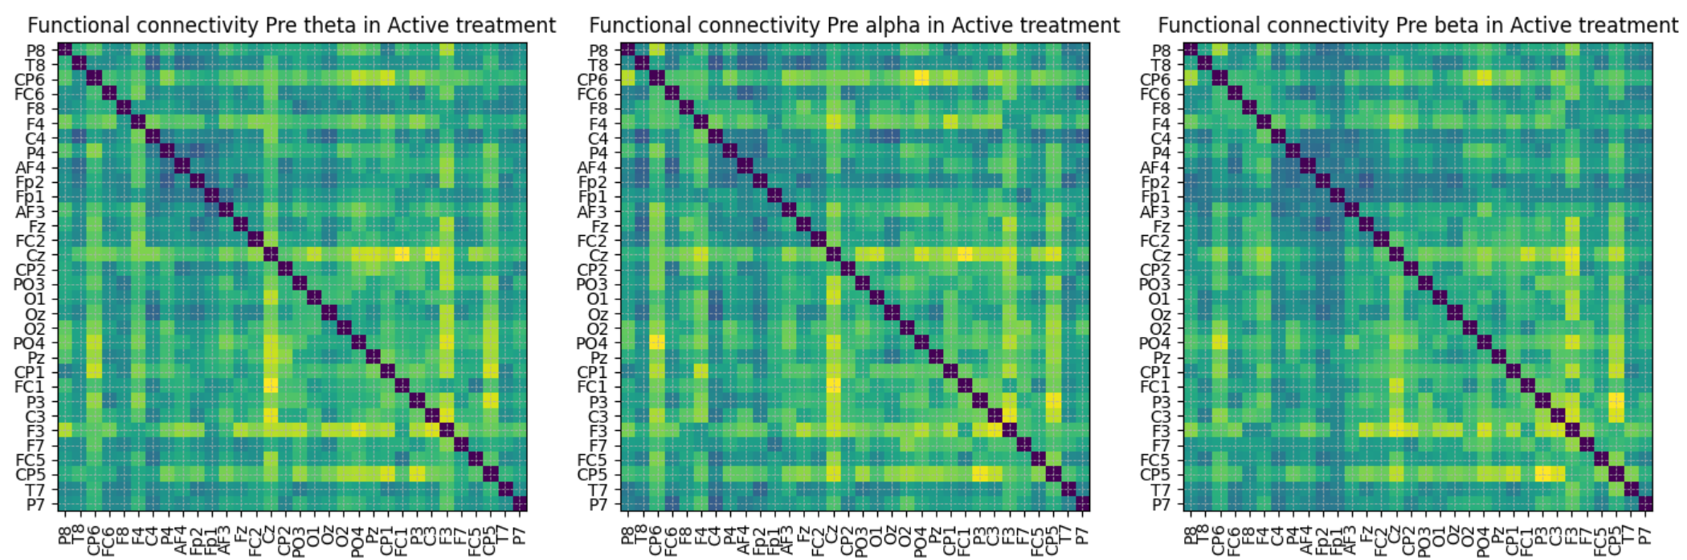
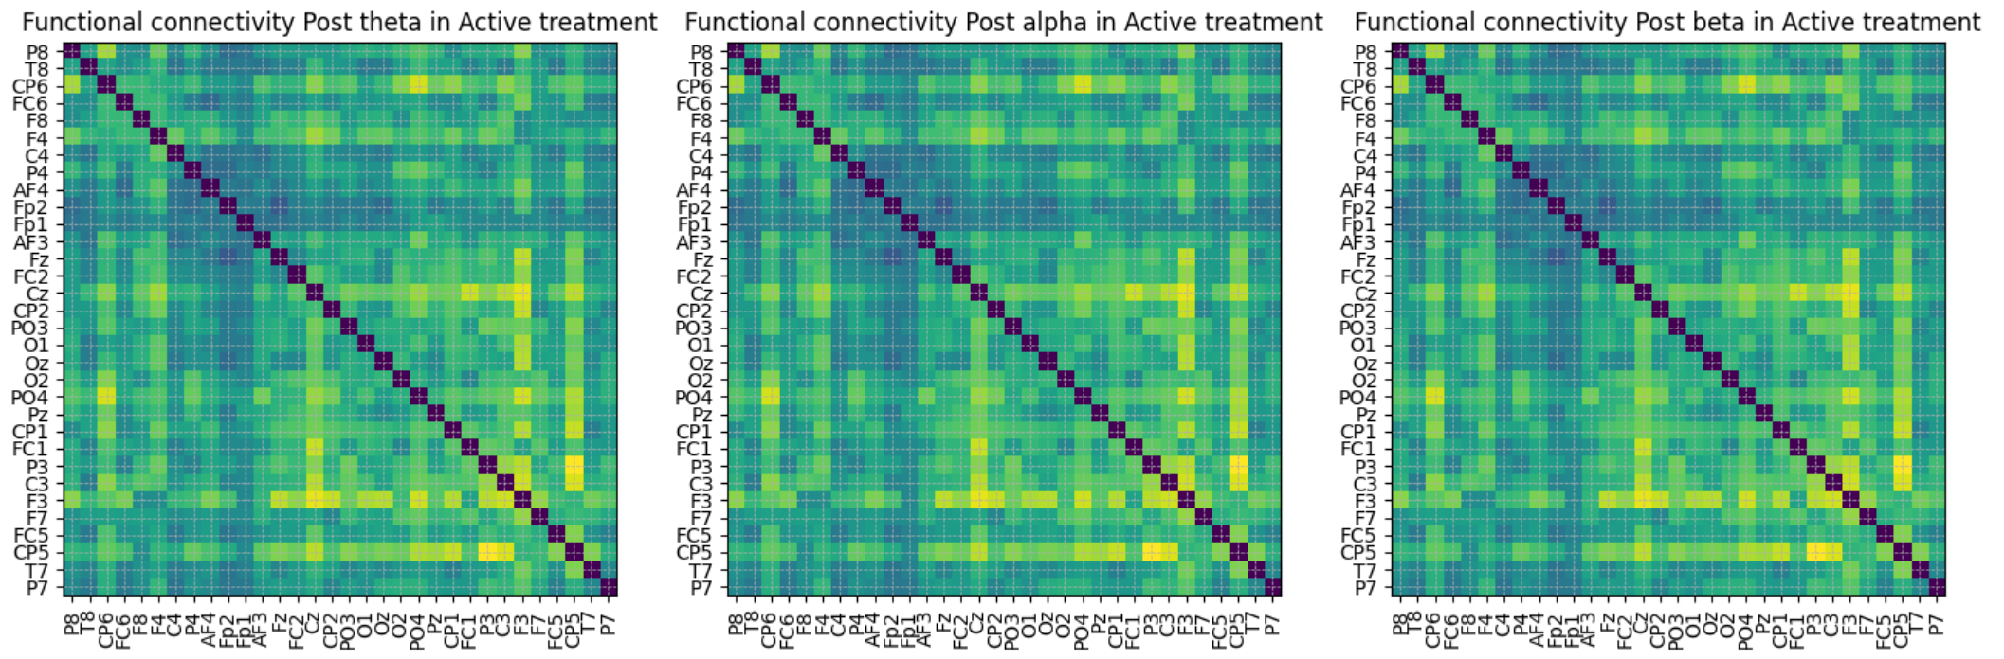

Slide 16
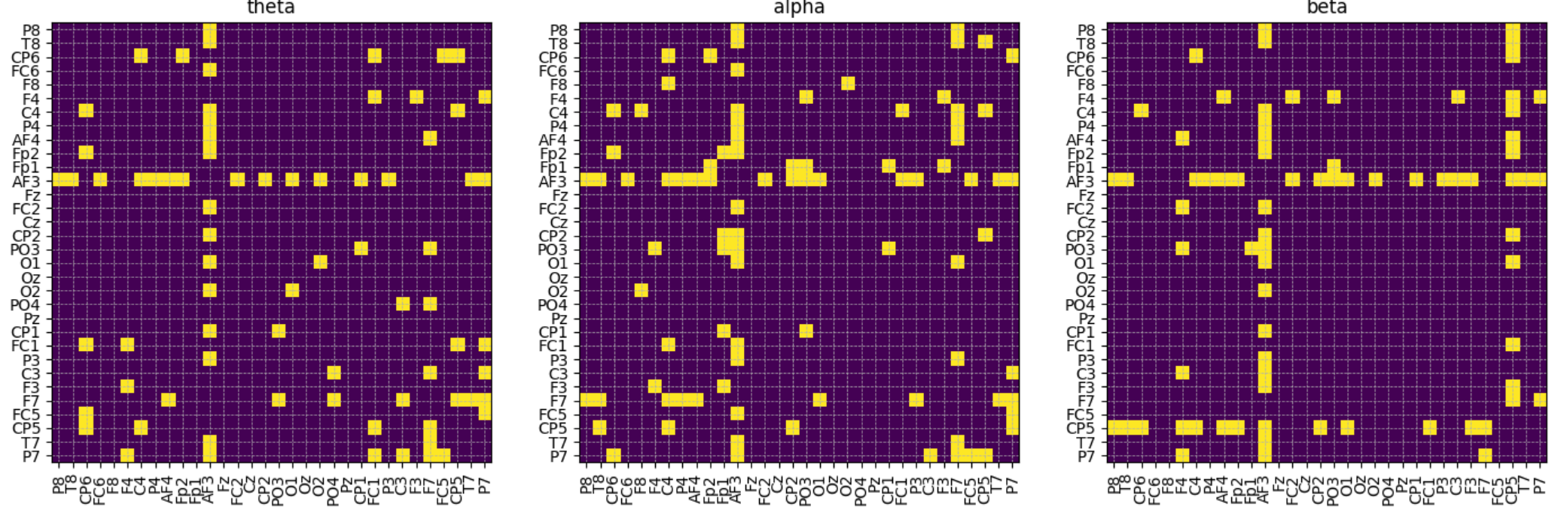
Post – pre binarized matrix

Slide 17
Hubness threshold: {'theta': 4.836701429477554, 'alpha': 5.06632414300902, 'beta': 5.672107705392095}
Selected channels: {'theta': ['CP6', 'AF3', 'F7', 'P7'], 'alpha': ['C4', 'AF3', 'F7', 'P7'], 'beta': ['F4', 'AF3', 'CP5']}
Selected regions{'theta': ['RC', 'LF', 'LPO'], 'alpha': ['RC', 'LF', 'LPO'], 'beta': ['RF', 'LF', 'LC']}

Slide 18
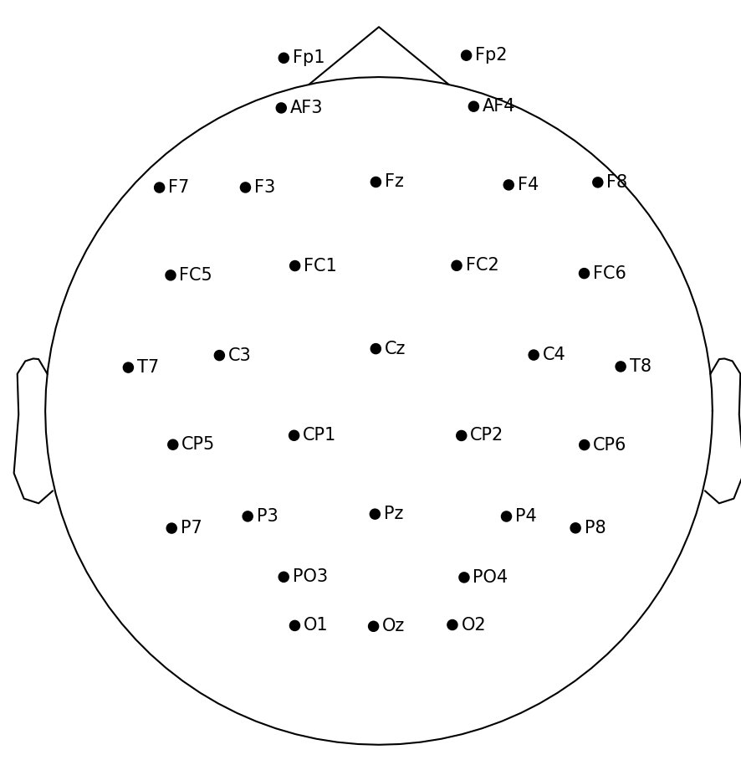
TODO: insert hub plots and brain net viewer plots and mark nodes calculated via hubness threshold

Slide 20
GROUP C: PRE-SHAM vs POST-SHAM – To find placebo effect

Slide 21
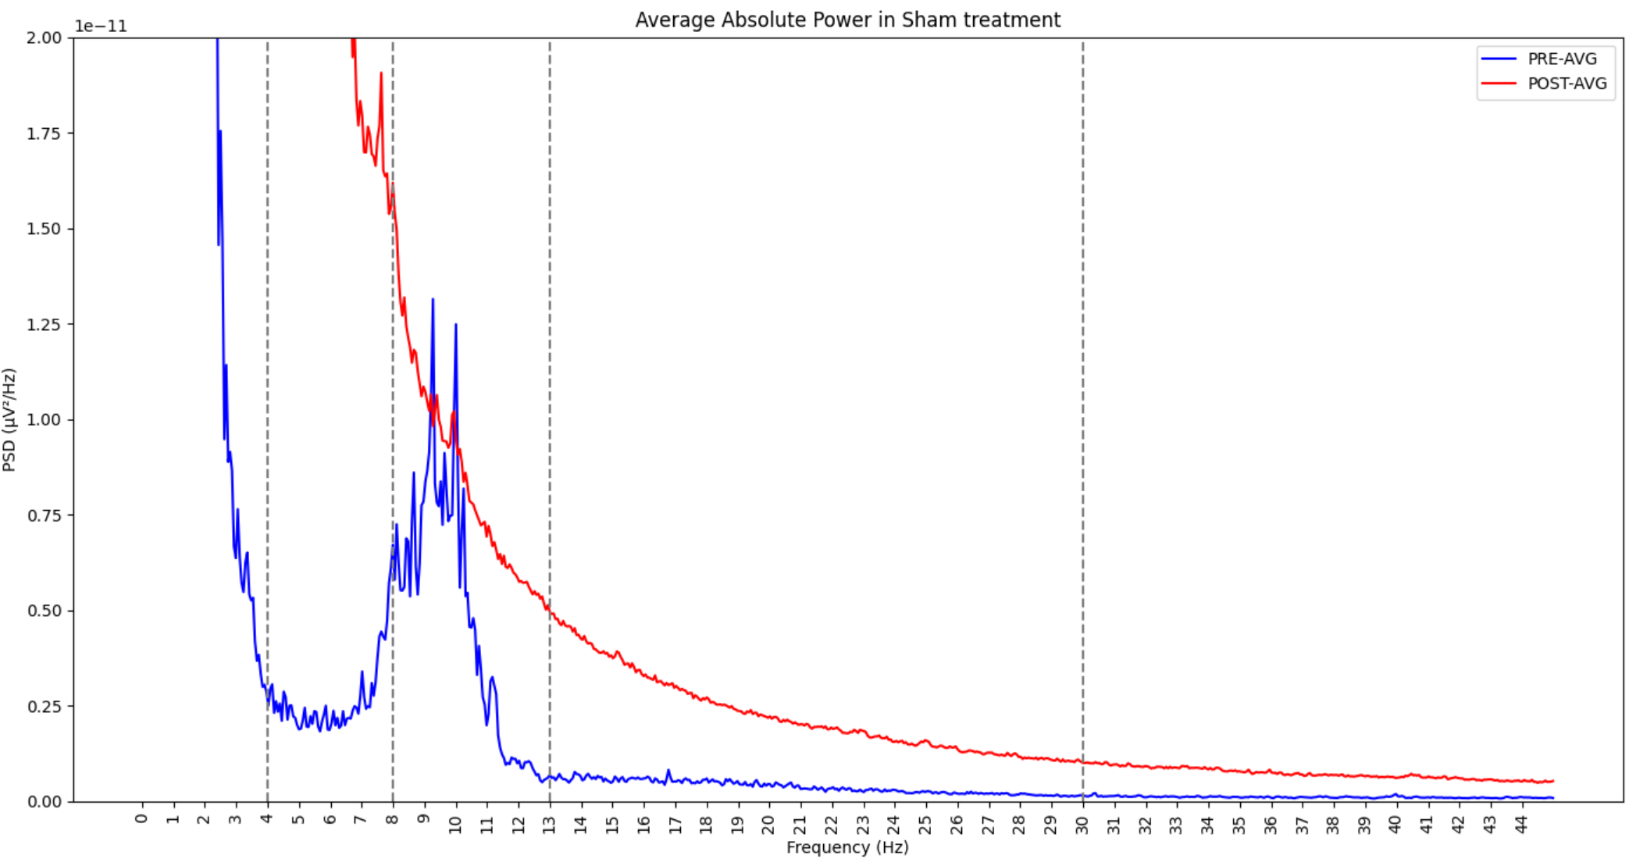

Slide 22
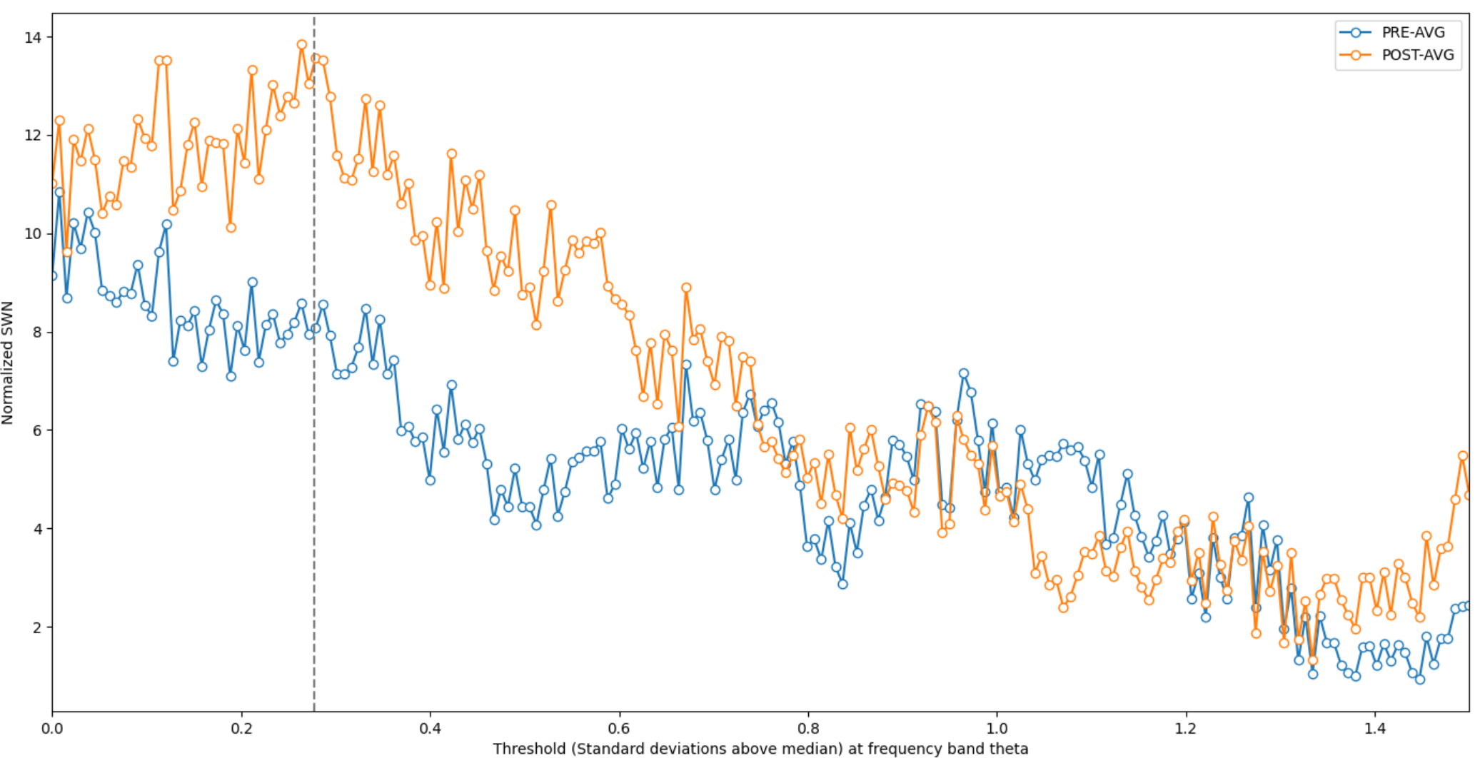

Slide 23
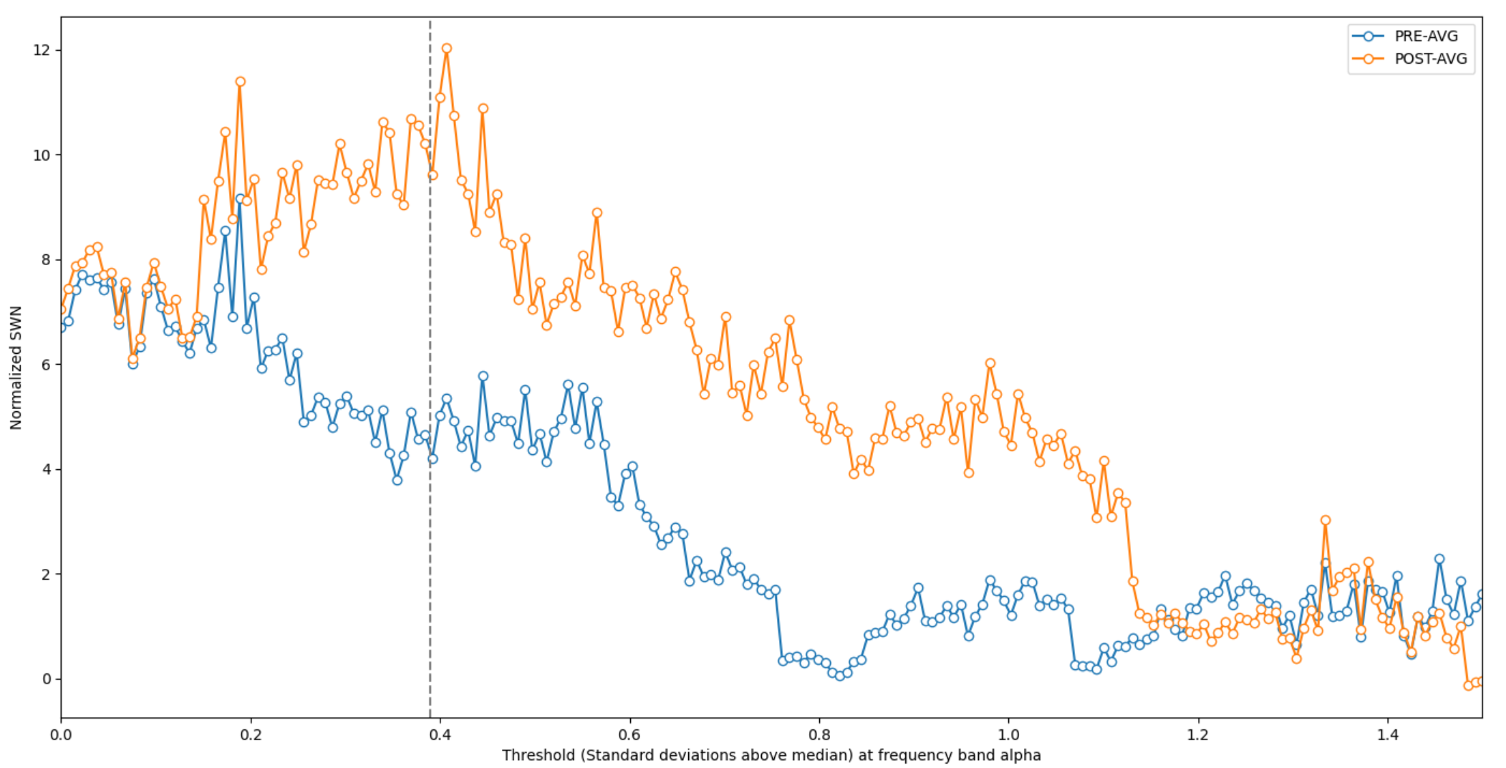

Slide 24
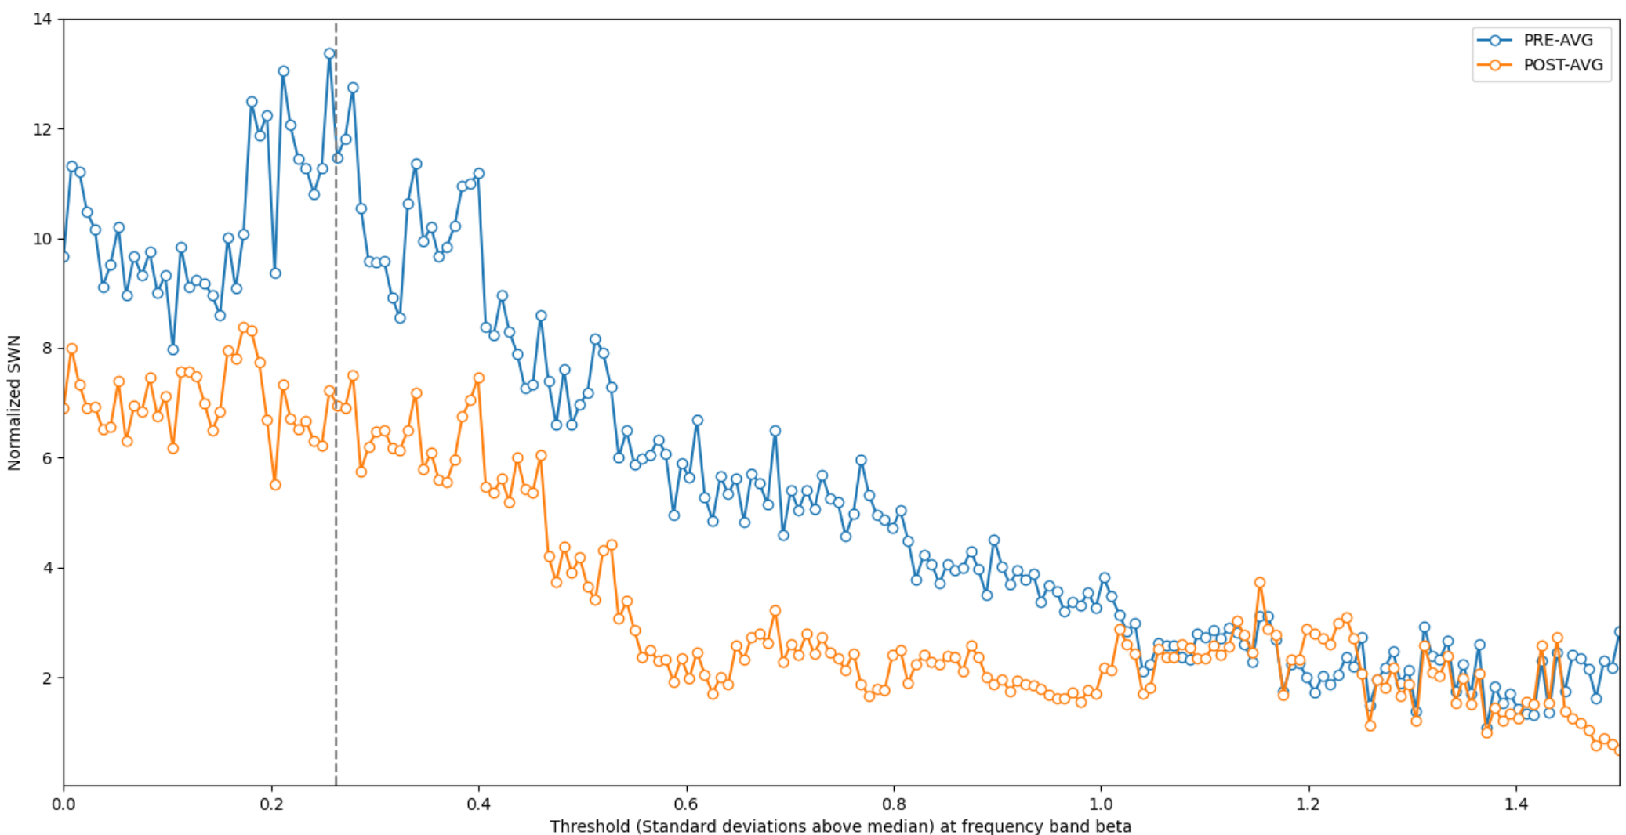

Slide 25
Common threshold: {'theta': 0.2788944723618091, 'alpha': 0.391959798994975, 'beta': 0.2638190954773868}
Threshold for theta - Pre: 0.40750269679084 Post: 0.4925411889867916
Threshold for alpha - Pre: 0.4802009991135391 Post: 0.5056581715335278
Threshold for beta - Pre: 0.4388993597150827 Post: 0.5188395392070808

Slide 26
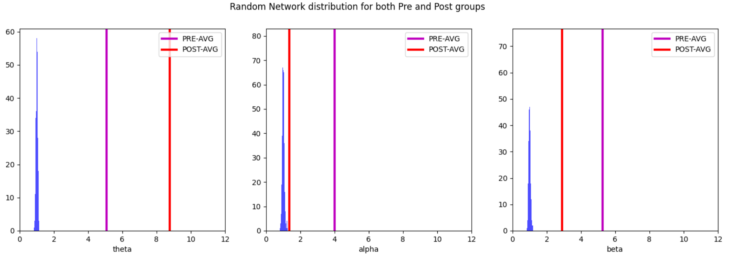
alpha pre p-value: 0.001
All else: 0.0

Slide 27
PRE-AVG-theta-number of links: K= 191
POST-AVG-theta-number of links: K= 191
PRE-AVG-alpha-number of links: K= 176
POST-AVG-alpha-number of links: K= 197
PRE-AVG-beta-number of links: K= 199
POST-AVG-beta-number of links: K= 188
PRE-AVG: theta left region: 130 right region: 124 proportion: 1.0483870967741935
POST-AVG: theta left region: 154 right region: 131 proportion: 1.1755725190839694
PRE-AVG: alpha left region: 135 right region: 104 proportion: 1.2980769230769231
POST-AVG: alpha left region: 145 right region: 133 proportion: 1.0902255639097744
PRE-AVG: beta left region: 148 right region: 119 proportion: 1.2436974789915967
POST-AVG: beta left region: 138 right region: 127 proportion: 1.0866141732283465

Slide 28
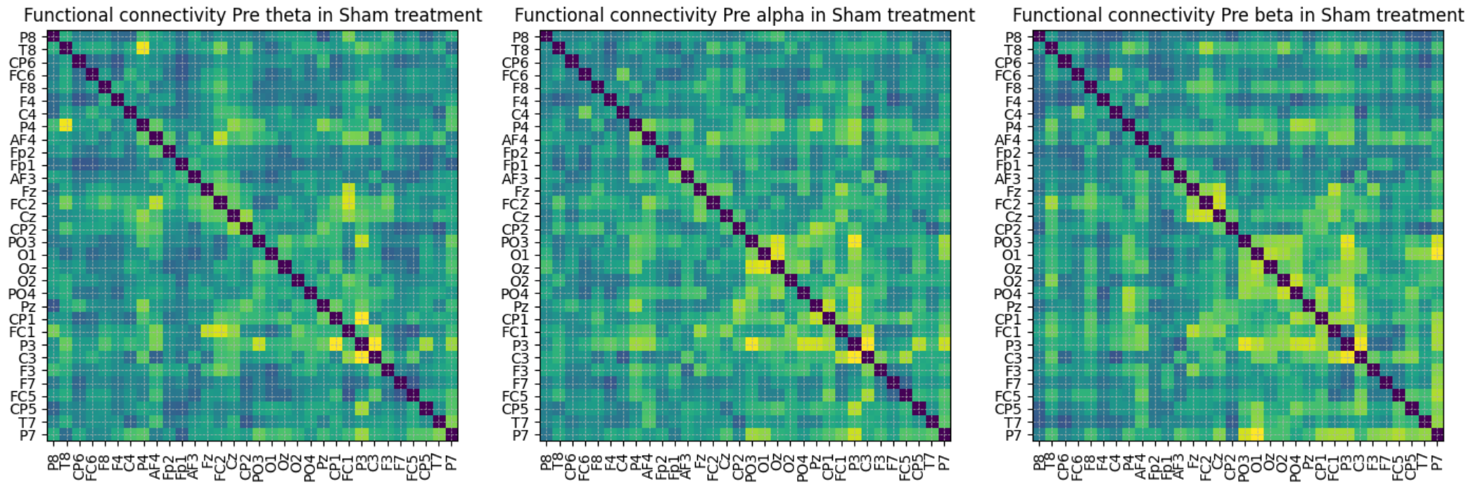
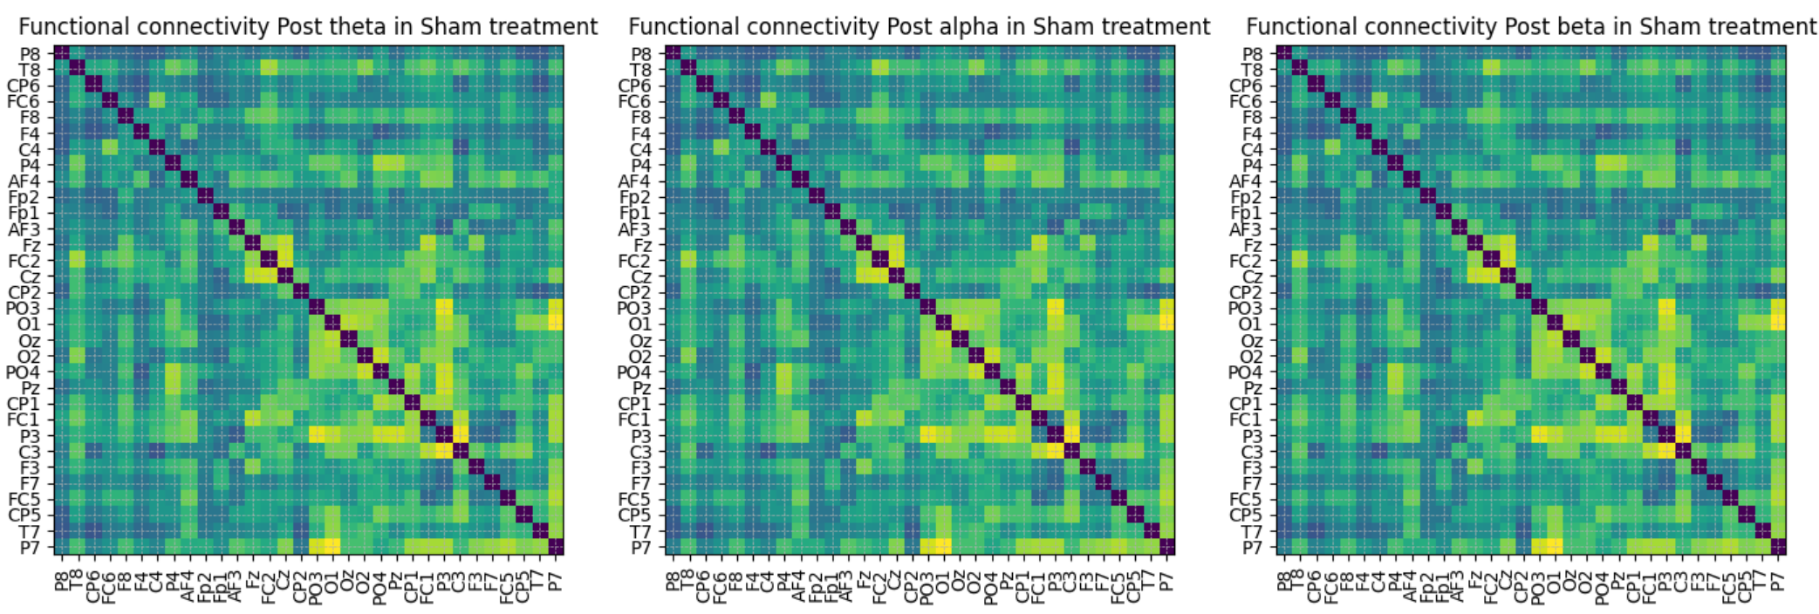

Slide 29
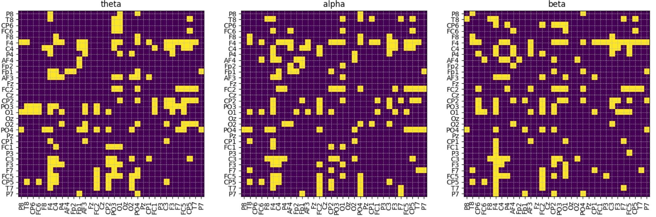

Slide 30
Hubness threshold:{'theta': 8.067785023818246, 'alpha': 7.868442031360946, 'beta': 7.979930118733242}
Selected channels: {'theta': ['F4', 'C4', 'PO3', 'O1', 'PO4'], 'alpha': ['F4', 'C4', 'FC2', 'CP2', 'O1', 'PO4', 'C3', 'CP5'], 'beta': ['F4', 'FC2', 'CP2', 'O1']}
Selected regions: {'theta': ['RPO', 'RC', 'LPO', 'RF'], 'alpha': ['RPO', 'LC', 'LPO', 'RC', 'RF'], 'beta': ['RC', 'LPO', 'RF']}
Hubness threshold: {'theta': 10.101677535727367, 'alpha': 9.802663047041419, 'beta': 9.969895178099863}
Selected channels: {'theta': ['F4', 'PO3', 'O1', 'PO4'], 'alpha': ['F4', 'FC2', 'O1', 'PO4'], 'beta': ['F4', 'FC2', 'CP2', 'O1']}
Selected regions: {'theta': ['RPO', 'LPO', 'RF'], 'alpha': ['RPO', 'RC', 'LPO', 'RF'], 'beta': ['RC', 'LPO', 'RF']}

Slide 32
GROUP D: ACTIVE vs SHAM – Individual comparison – WHOLE brain

Slide 33
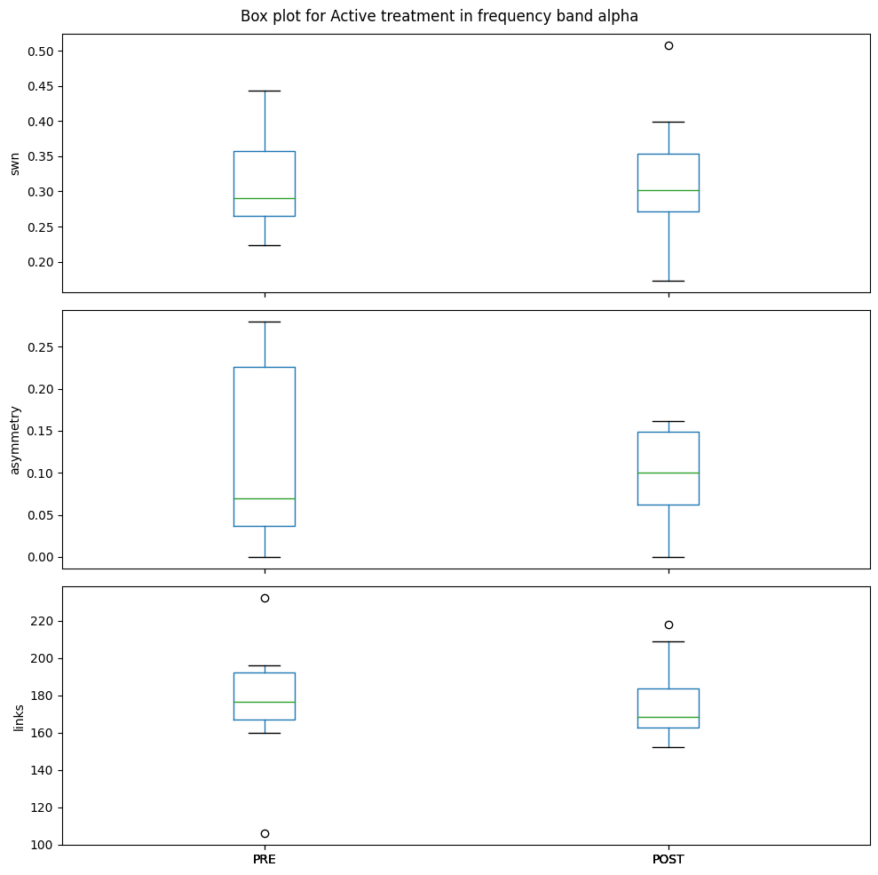
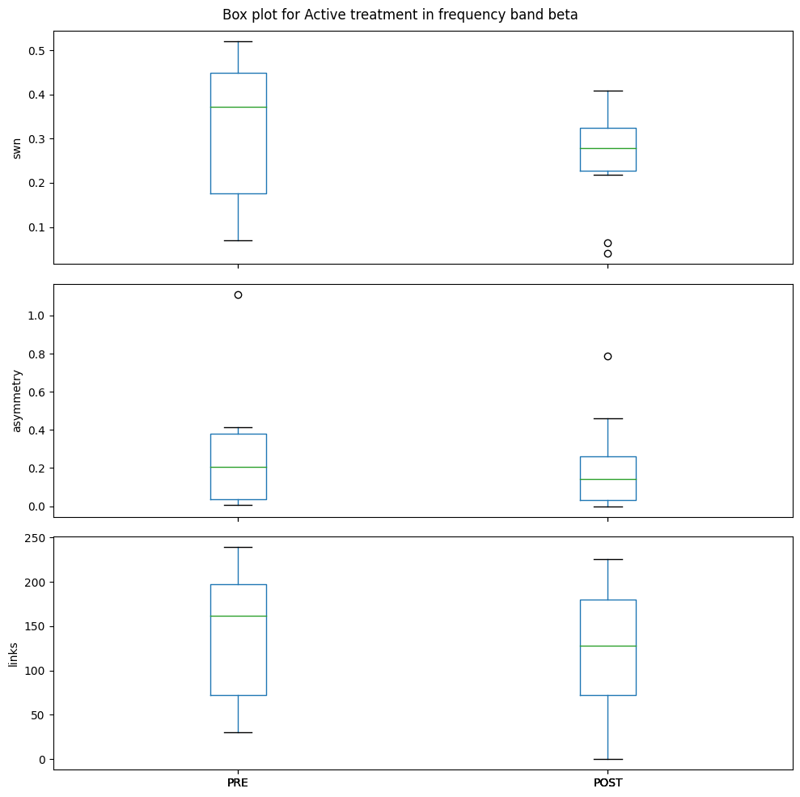
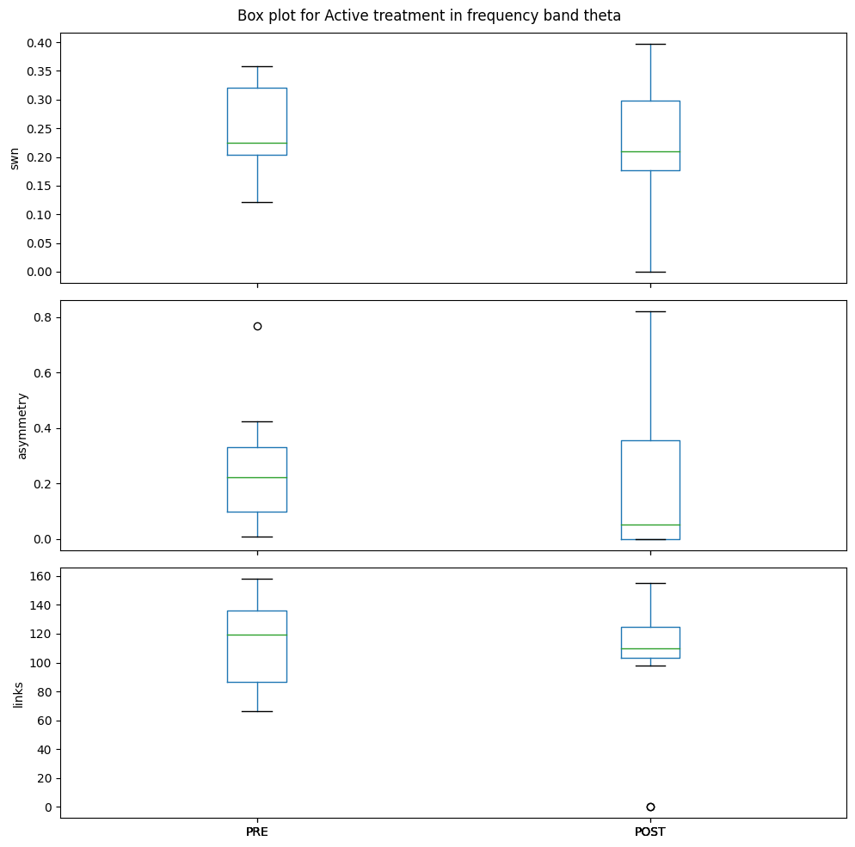
ACTIVE – Whole brain
swn, p-value: 0.21005266342185938
asymmetry, p-value: 0.6531841336259725
links, p-value: 0.2566676025384826
swn, p-value: 0.8859422164471326
asymmetry, p-value: 0.5389740869945496
links, p-value: 0.9873577937363069
swn, p-value: 0.7801371178531722
asymmetry, p-value: 0.7919487784914802
links, p-value: 0.8444521391697728

Slide 34
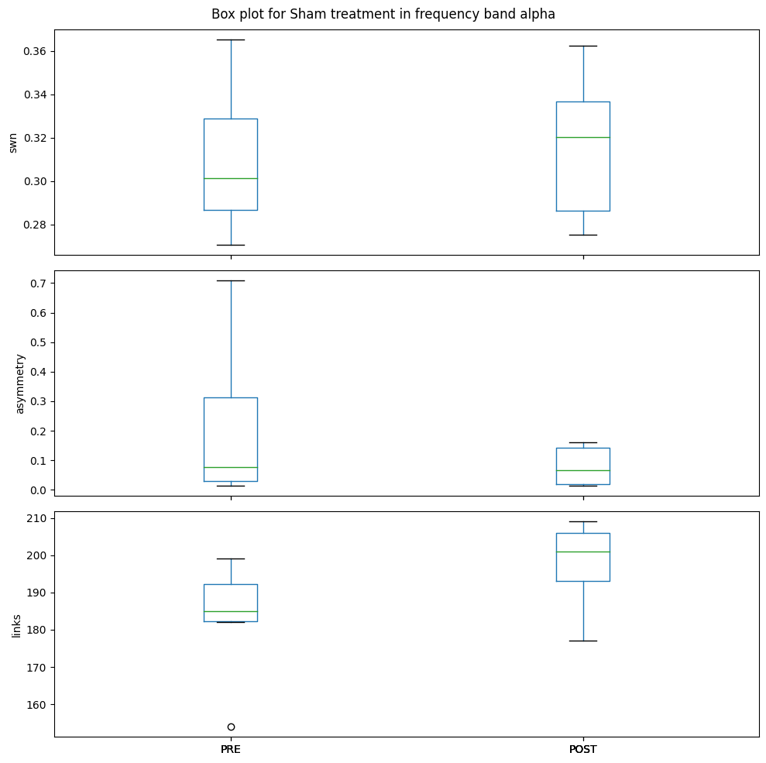
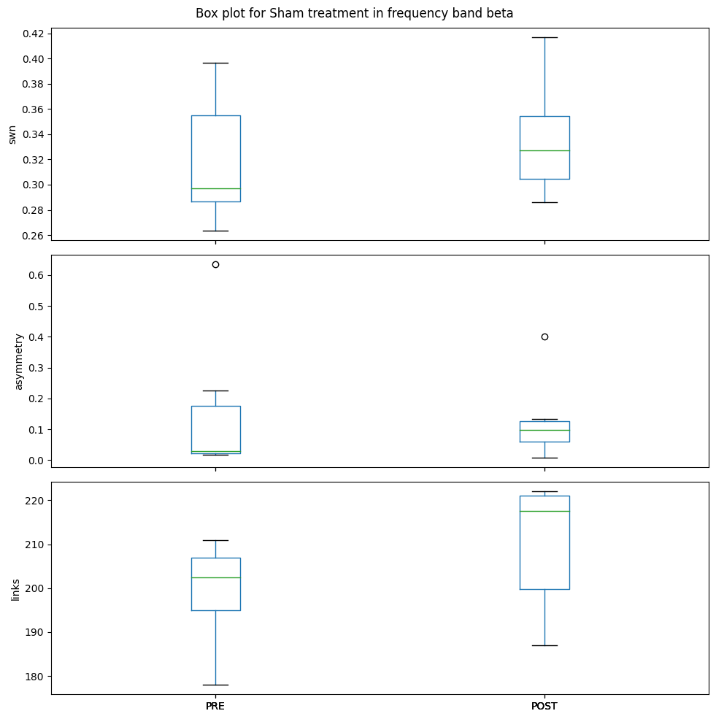
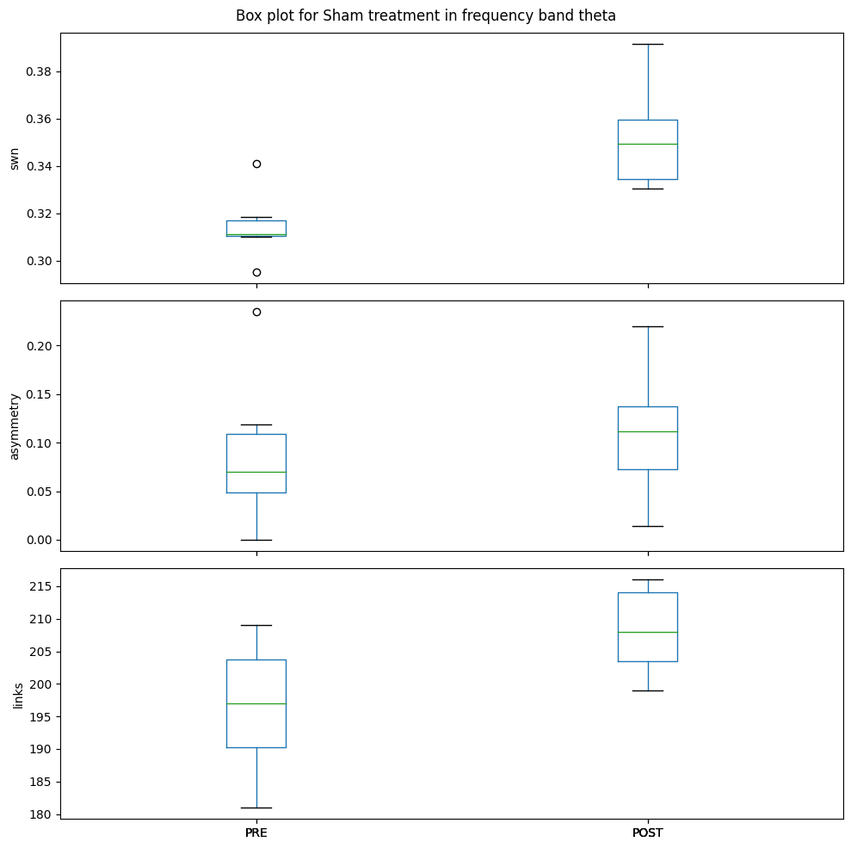
SHAM – whole brain
swn, p-value: 0.016710155432856463
asymmetry, p-value: 0.709213168503446
links, p-value: 0.09454713141969677
swn, p-value: 0.3835262896663147
asymmetry, p-value: 0.8209976995336448
links, p-value: 0.11376439644603527
swn, p-value: 0.7178620012405392
asymmetry, p-value: 0.3696859924281325
links, p-value: 0.1821157415179071

Slide 35
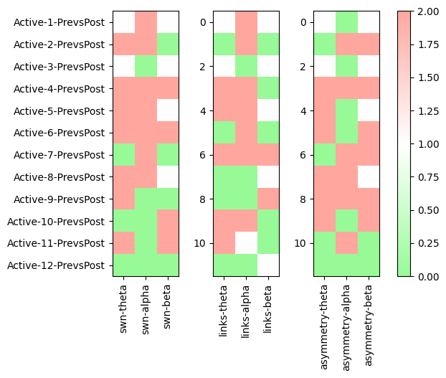
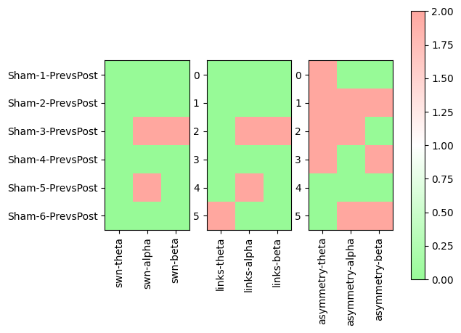

Slide 36
ACTIVE vs SHAM – Individual comparison​ - REGION SPECIFIC ​ ​ ​ ​

Slide 37
Algorithm:
White :
disconnected graph or almost equal links whole brain --- if disconnected -> isignificant bands and NaN both I, I+1
disconnected graph or almost symmetric graphs whole brain --- if disconnected NaN both I, I+1
disconnected or incomparable graphs i.e both having 0.0 swn metric
Green :
post links > pre links whole brain
pre asymmetry > post asymmetry whole brain
post swn >= pre swn
Red:
pre links > post links whole rbain
post asymmetry > pre asymmetry wholoe brain
pre swn > post swn

Slide 38
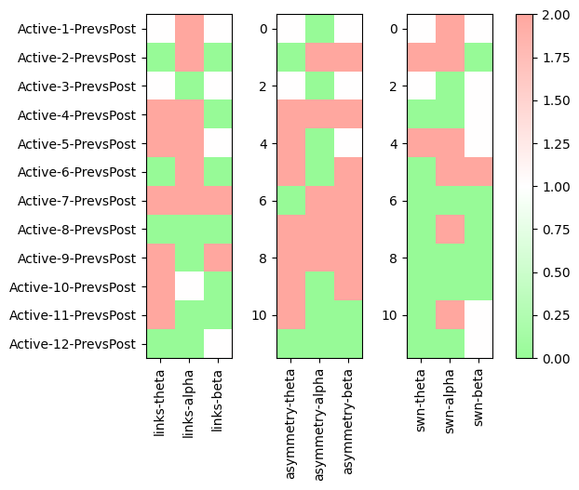
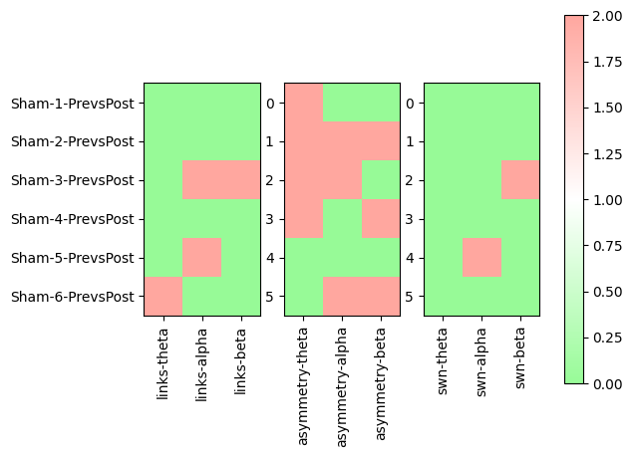

Slide 39
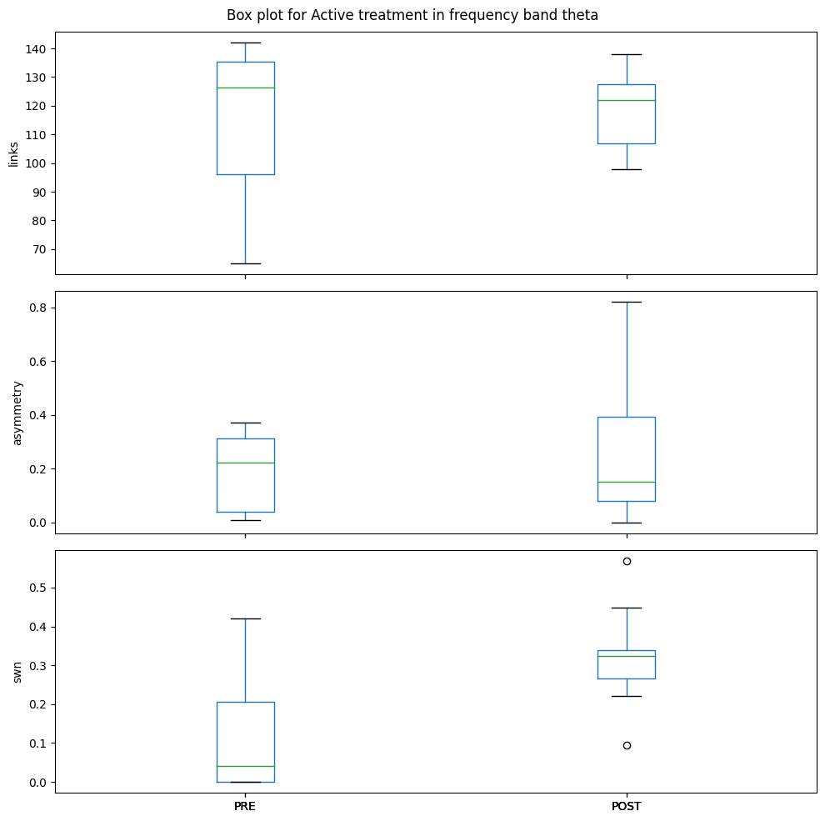
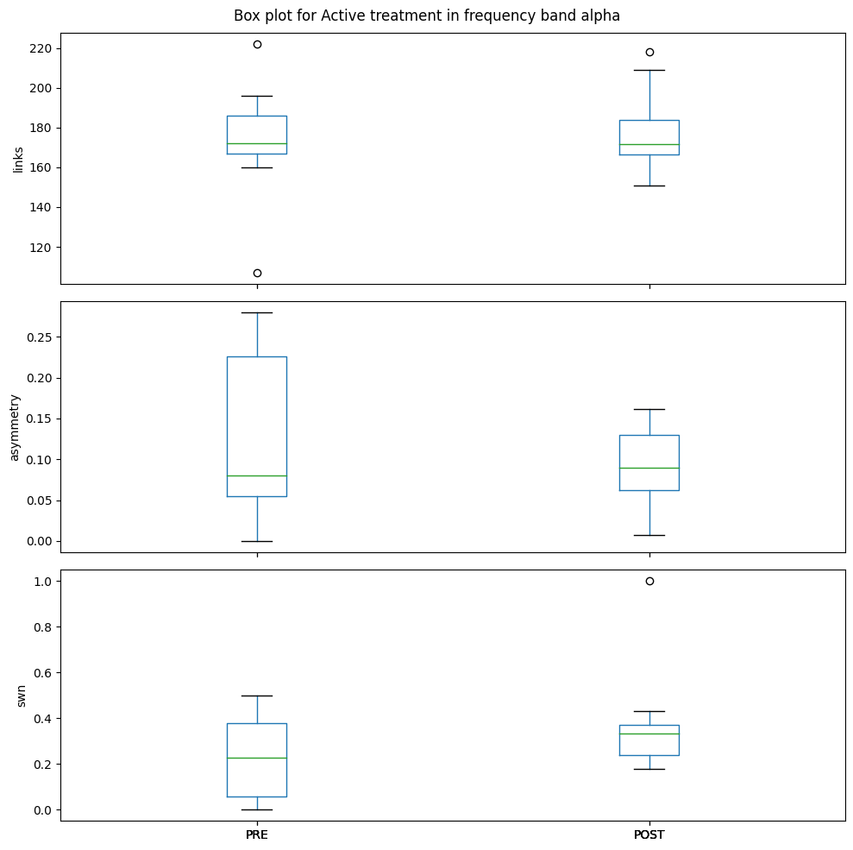
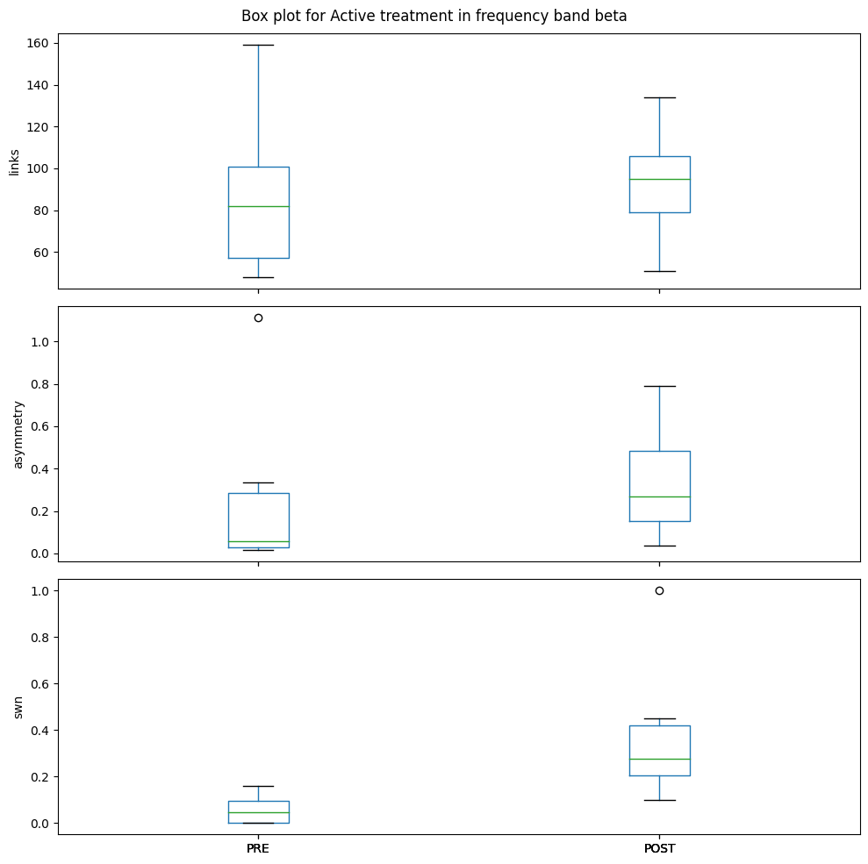
ACTIVE – Region spec
links, p-value: 0.7470917441054767
asymmetry, p-value: 0.3335180273171864
swn, p-value: 0.01061493755855462
links, p-value: 0.7496514206646507
asymmetry, p-value: 0.28334571704194605
swn, p-value: 0.1971180633257393
links, p-value: 0.594914050208188
asymmetry, p-value: 0.4008255458219109
swn, p-value: 0.08526918549668883
LC 1.8929973161526934
LF 1.8765082903320336

Slide 40
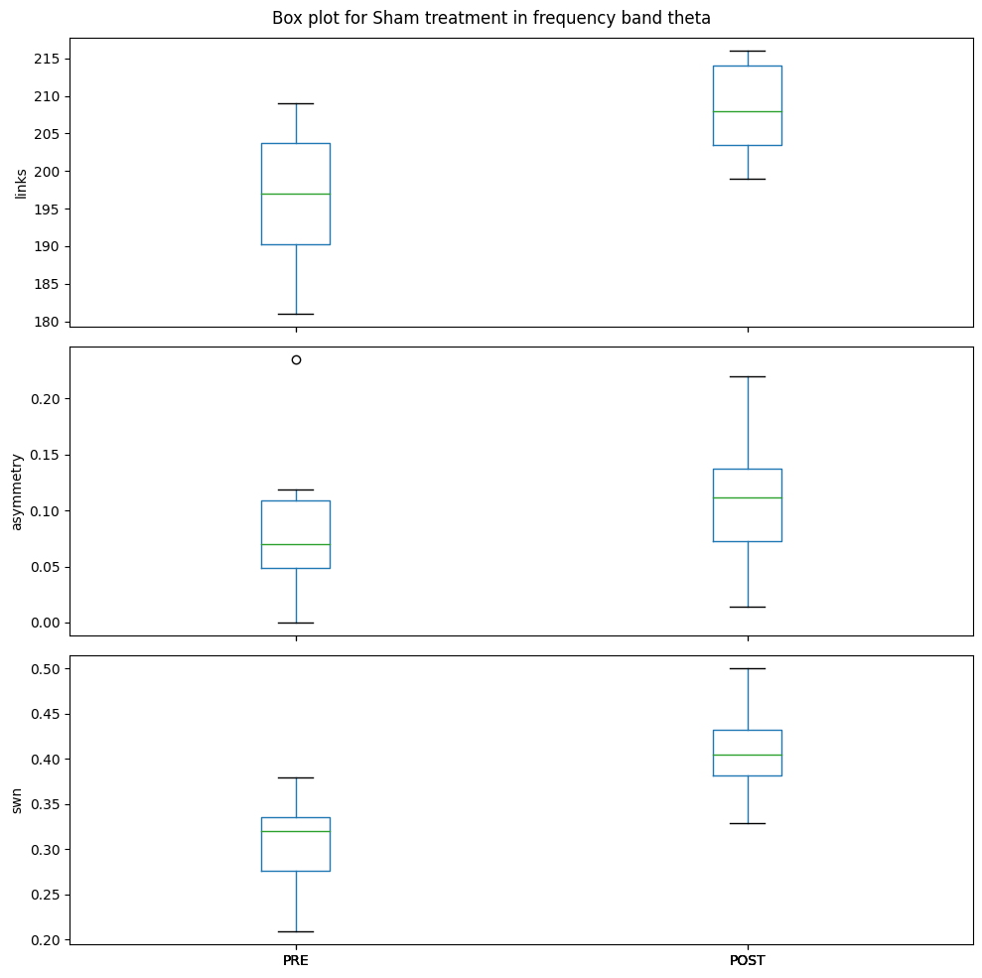
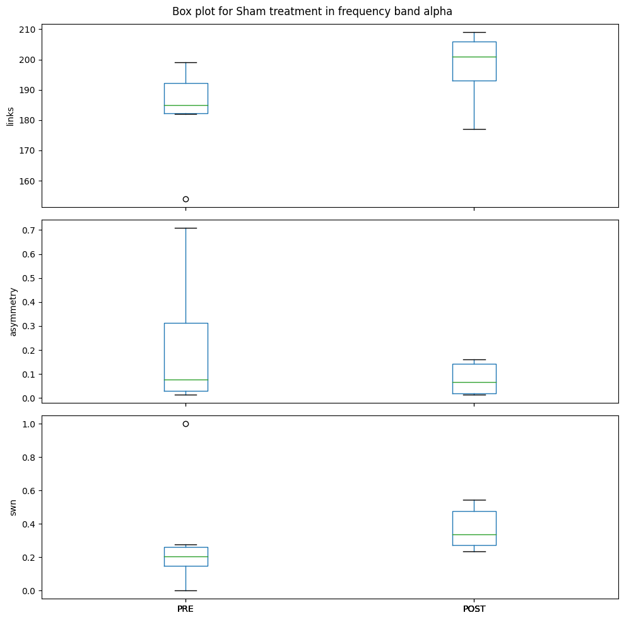
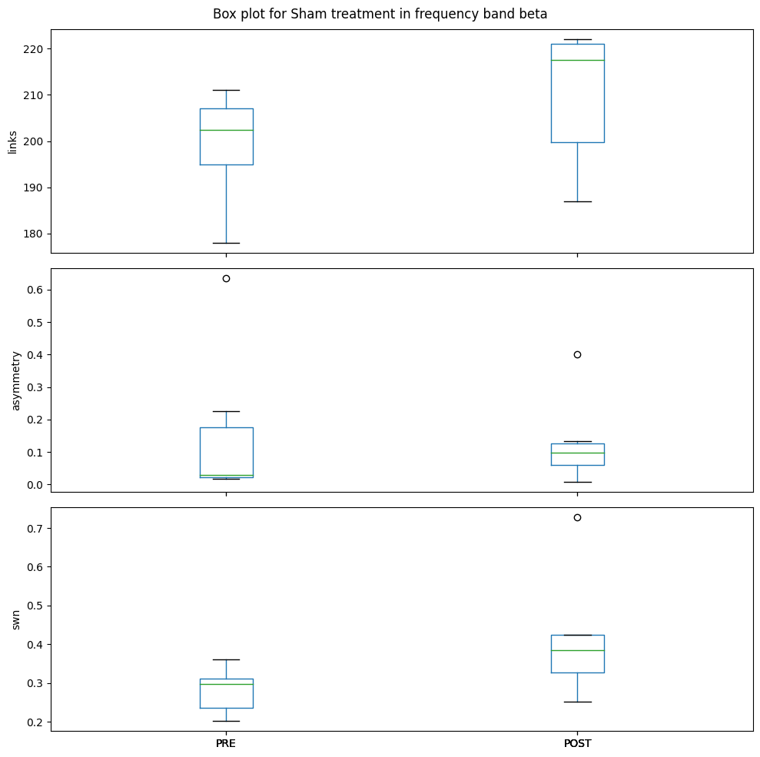
SHAM– Region spec
links, p-value: 0.09454713141969677
asymmetry, p-value: 0.7092131685034189
swn, p-value: 0.0155754578998429
links, p-value: 0.11376439644603527
asymmetry, p-value: 0.8209976995336383
swn, p-value: 0.14650213222380373
links, p-value: 0.1821157415179071
asymmetry, p-value: 0.3696859924281306
swn, p-value: 0.5639058935694304
RC 0.623029959955375
RPO 0.558734898432919

Slide 42
5. Asymmetry ratio in all bands: (#left_edges/#right_edges)

Slide 43
Freq bands | Pre active | Post active
delta | 1.0895522388059702 | 0.9663608562691132
theta | 2.25 | 1.1818181818181819
alpha1 | 1.4683544303797469 | 1.1
alpha2 | 1.9 | 1.1666666666666667
beta1 | 1.6666666666666667 | 1.5263157894736843

Slide 44
https://www.sciencedirect.com/science/article/pii/S0149763419303823
Depressed present a more random brain network structure. (iNSERT COMPARISON OF BOTH DEPRESSED AND HEALTHY)
Alpha and theta at left hemisphere as classificatioU+006e : Hosseinifard et al. (2013),
high-alpha and delta and no region : Mohammadi et al. (2015)
Correlates increased alpha activity during whole night sleep to increased suicide ideation in depressed subjects : Dolsen et al. (2017)
Increased gamma power in monopolar depressed compared to healthy controls. : Fitzgerald and Watson (2018)
Increased Delta, Theta at the central parietal and lateral areas.: Liu et al. (2017)
Increased Alpha, Beta, Theta at occipital and parietal areas of the brain of depressed subjects.: Grin-Yatsenko et al. (2010)
Left alpha activity is a good predictor for depression diagnosis. : Lee et al. (2018) and Hosseinifard et al. (2013)
Review study concludes that alpha asymmetry may be suitable for treatment prediction, but not for diagnosis. : van der Vinne et al. (2017)
Brain laterality review, concludes that other features, such as gender and comorbidity play a role in alpha asymmetry. : Bruder et al. (2017)
Relates alpha asymmetry to unipolar (lack of approach motivation) and bipolar (excess of approach motivation) depressive disorders. : Nusslock et al. (2015)
Frontal alpha asymmetry is related to depression only in females, finding no significance for males. : Jesulola et al. (2017)
No gender impact on alpha asymmetry. Also increased left alpha activity mostly at frontal and central-parietal locations for lifetime MDD. : Smith et al. (2018)
Higher alpha activity at the left hemisphere for MDD subjects when compared to healthy controls. : Koo et al. (2018)
Could not classify depressed versus healthy using asymmetry. : Cai et al. (2017)
Some features, e.g. alpha asymmetry, are useful when detecting specific symptoms. Gamma band activity warrants further investigation due to its relationship with mood regulation, while increased alpha band activity during sleep may be linked to suicidal ideation. Alpha band features, such as alpha asymmetry and EEG vigilance, may serve as predictors for specific symptoms. Theta waves show potential as diagnostic tools, although mechanisms related to them require further exploration. Beta waves appear to be more related to anxiety and rumination rather than specific diagnostic markers for depression.
Alpha asymmetry seem to be an efficient biomarker for specific symptoms, as dysphoria and lassitude (Nelson et al., 2018) and to differ unipolar from bipolar depression (Nusslock et al., 2015), but has little diagnostic power given its sensibility to other factors specially anxiety, future studies should explore its sensibility to other external factors before using it for diagnostic prediction.
Reduced alpha band in post as compared to pre
Reduced asymmetry in all bands in post as compared to pre (alpha band asymmetry can be a potential biomarker)
Anyhow Increased LF, LC activity in post as compared to pre and more connectionas in post overall, RC in theta and RPO in alpha2

Slide 46
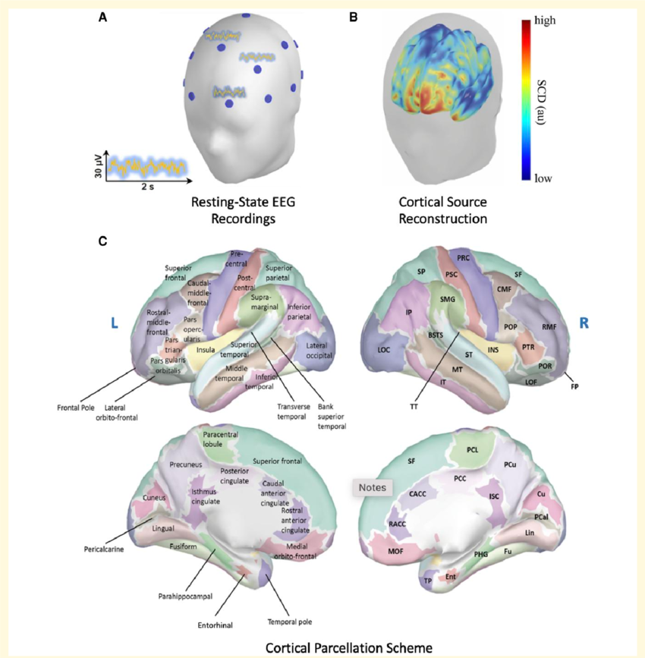
TODO: We can use different parcellation schemes

Slide 47
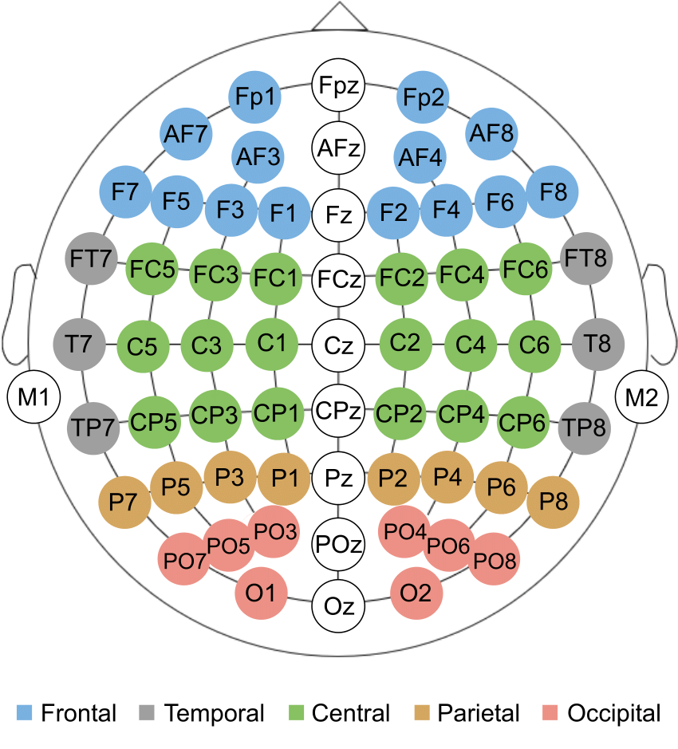

Slide 48
9. Calculate network metrics – shortest average path, global efficiency, local effciicency,
Clustering coefficient, node betweenness centrality
Alternatives: Cross check using correlation coefficient, coherence, phase synch, granger causality

Slide 49
Small-World Network (As in paper):
Focus: Small-world properties primarily look at the overall efficiency of information transfer in a network, emphasizing short path lengths and high clustering.
Applications: If your goal is to understand how efficiently information can propagate across different regions of the brain, or if you are interested in the global connectivity patterns, small-world network analysis might be more appropriate.
Community Structure:
Focus: Community structure analysis is concerned with identifying groups of nodes that are more densely connected among themselves than with the rest of the network.
Applications: If your interest lies in identifying functional or anatomical modules within the brain, where certain regions work more closely together, community structure analysis could be more relevant. This is particularly useful when studying localized functional networks or understanding how different brain regions contribute to specific functions.

